Slide 1
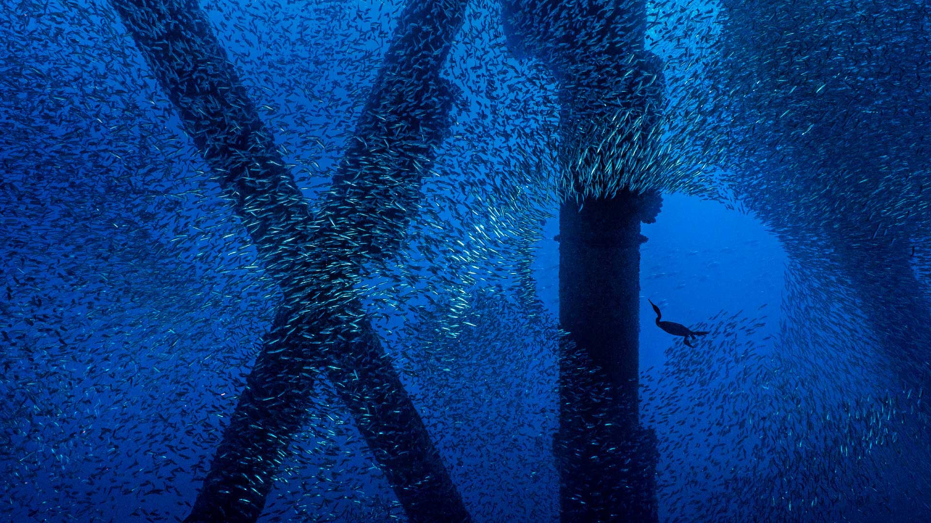

Slide 2


Copyright And Confidentiality
All content of this material, including text, images, audio, video,software,programs,tools etc., are collected online.
Visitors may use the content or services provided in this material for personal study, research or appreciation, as well as other non-commercial or non-profit uses, but at the same time comply with the provisions of the Copyright Law and other relevant laws, and may not infringe this information and related the legal rights of the right holder. In addition, any use of any content or service of this material for other purposes requires the written permission of the person and payment.
牧云/罗伟
Network | IaaS | PaaS | ServiceMesh
交流 学习 沉淀 成长 分享
olaf.luo@foxmail.com
https://www.yuque.com/wei.luo
https://youdianzhishi.com
All Rights Reserved.

Slide 3
Rowan Luo
交流
学习
沉淀
成长
分享
Kubernetes CNI - Calico VxLAN Mode
Revision Date: 2023/02/23
Version：v1.2
DocID：CN00002023XLW

Slide 4
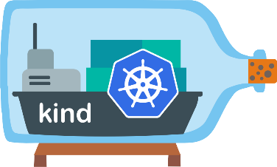
Calico VxLAN Mode - Prepare Environment
Linux Bridge
172.18.0.1/16

Slide 5
Calico VxLAN Mode - Prepare Environment
# 1.prep noCNI env
cat <<EOF | kind create cluster --name=calico-vxlan --image=kindest/node:v1.23.4 --config=-
kind: Cluster
apiVersion: kind.x-k8s.io/v1alpha4
networking:
disableDefaultCNI: true
nodes:
- role: control-plane
- role: worker
- role: worker
containerdConfigPatches:
- |-
[plugins."io.containerd.grpc.v1.cri".registry.mirrors."192.168.2.100:5000"]
endpoint = ["http://192.168.2.100:5000"]
EOF
# 2.remove taints
controller_node=`kubectl get nodes --no-headers -o custom-columns=NAME:.metadata.name| grep control-plane`
kubectl taint nodes $controller_node node-role.kubernetes.io/master:NoSchedule-
kubectl get nodes -o wide
# 3. install CNI
kubectl apply -f calico.yaml
# 4. install necessary tools
for i in $(docker ps -a --format "table {{.Names}}" | grep calico-vxlan)
do
echo $i
docker cp /usr/bin/calicoctl $i:/usr/bin/calicoctl
docker cp /usr/bin/ping $i:/usr/bin/ping
docker exec -it $i bash -c "sed -i -e 's/jp.archive.ubuntu.com\|archive.ubuntu.com\|security.ubuntu.com/old-releases.ubuntu.com/g' /etc/apt/sources.list"
docker exec -it $i bash -c "apt-get -y update >/dev/null && apt-get -y install net-tools tcpdump lrzsz >/dev/null 2>&1"
done

Slide 6
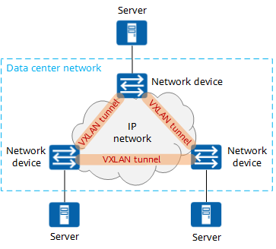
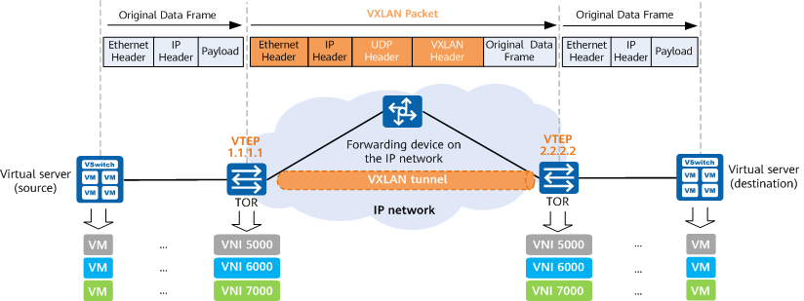
Calico VxLAN Mode - VxLAN Basics
Virtual eXtensible Local Area Network (VXLAN) is one of the Network Virtualization over Layer 3 (NVO3) technologies defined by the Internet Engineering Task Force (IETF) and is an extension to Virtual Local Area Network (VLAN). VXLAN encapsulates a Layer 2 Ethernet frame into a UDP packet and transmits the packet over a Layer 3 network.
As shown in Figure 1-1, VXLAN is essentially a tunneling technology. It establishes a logical tunnel on the IP network between the source and destination network devices to encapsulate user-side packets and forward them through the tunnel. Servers are connected to different ports of network devices in the data center VXLAN network, which can be considered as a virtual Layer 2 switch.

Slide 7

Calico VxLAN Mode - DataPath
HOST
host default ns
pod ns
Proxy ARP
app container
②: 0.0.0.0 169.254.1.1 0.0.0.0 UG 0 0 0 eth0
③: cat /proc/sys/net/ipv4/conf/cali4525d2a0b7b/proxy_arp == 1
pause container
Network Protocol Stack
Network Protocol Stack
172.17.0.1
10.244.0.2/32
docker0
$$①$$
ethx
vethA
eth0
kernel space
physical network
Docker spawns a container in the containers own network namespace (use the CLONE_NEWNET flag defined in sched.h when calling the clone system call to create a new network namespace) and later on runs a veth pair (a cable with two ends) between the container namespace and the host network stack.

Slide 8
Calico VxLAN Mode - DataPath
app container
app container
pause container
pause container
Network Protocol Stack(CT)
Network Protocol Stack(CT)
10.244.0.2/32
10.244.0.3/32
eth0
eth0
Network Protocol Stack(CT)
vethx
vethn
HOST
ethx

Slide 9
Calico VxLAN Mode - DataPath
Node-X
Node-Y
Pod1
Pod2
process
process
tcp/ip stack
tcp/ip stack
veth
veth
veth
veth
vxlan.calico
VxLAN encapsulate
vxlan.calico
ethx
ethx
SW

Slide 11
Copyright And Confidentiality
All content of this material, including text, images, audio, video,software,programs,tools etc., are collected online.
Visitors may use the content or services provided in this material for personal study, research or appreciation, as well as other non-commercial or non-profit uses, but at the same time comply with the provisions of the Copyright Law and other relevant laws, and may not infringe this information and related the legal rights of the right holder. In addition, any use of any content or service of this material for other purposes requires the written permission of the person and payment.
牧云/罗伟
Network | IaaS | PaaS | ServiceMesh
交流 学习 沉淀 成长 分享
olaf.luo@foxmail.com
https://www.yuque.com/wei.luo
https://youdianzhishi.com
All Rights Reserved.

Slide 12


